Slide 1
CPSC 4430/5440: Machine Learning Lesson D04(b): Optimization for the Training Neural Networks
Lecture 7 -
1
Fei-Fei Li & Justin Johnson & Serena Yeung Lecture 7 - April 24, 2018

Slide 2
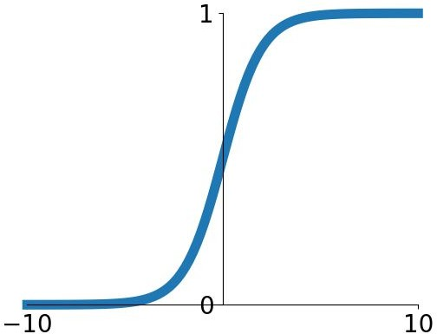
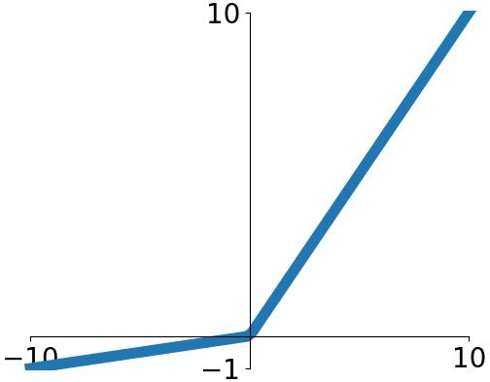
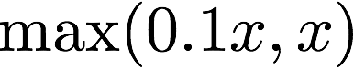
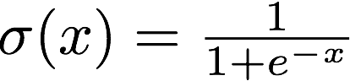
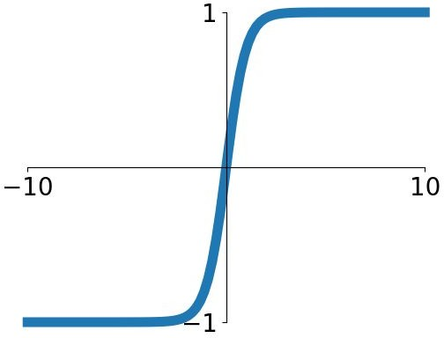
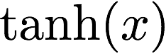
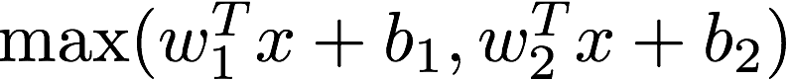
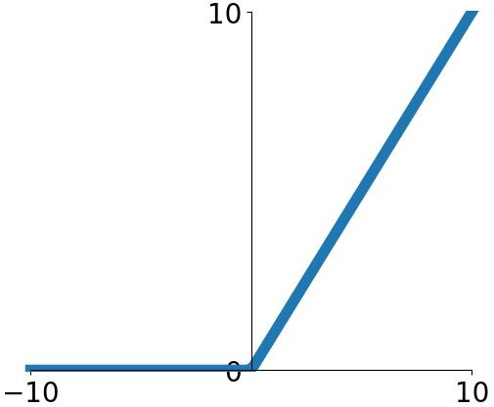
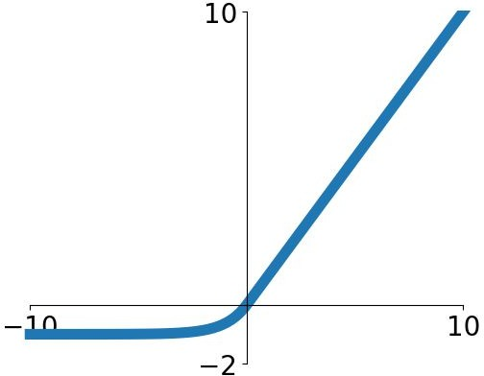
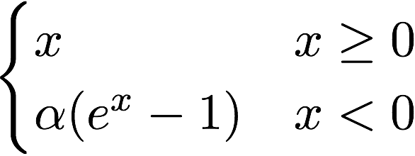
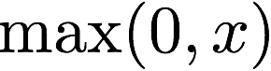
Last time: Activation Functions
Sigmoid
tanh
Leaky ReLU
Maxout
ReLU
ELU
Lecture 7 -
2
Fei-Fei Li & Justin Johnson & Serena Yeung Lecture 7 - April 24, 2018

Slide 3
Last time: Activation Functions
Sigmoid
tanh
Leaky ReLU
Maxout
ReLU
Good default choice
ELU
Lecture 7 -
3
Fei-Fei Li & Justin Johnson & Serena Yeung Lecture 7 - April 24, 2018

Slide 4
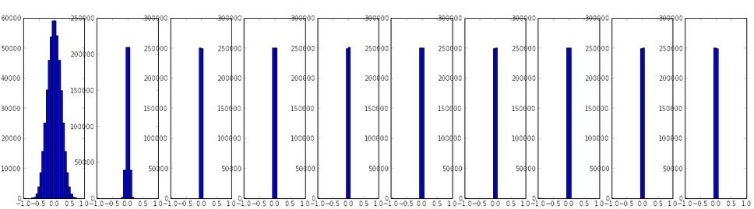
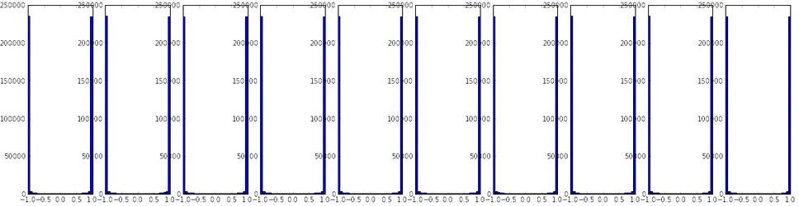
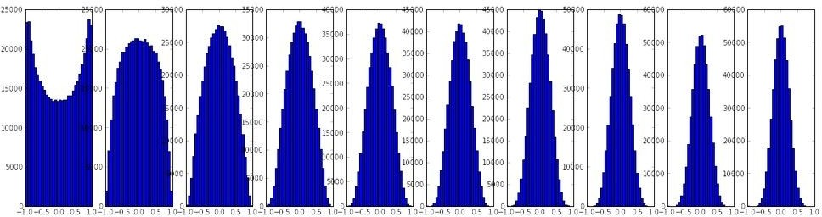
Last time: Weight Initialization
Initialization too small:
Activations go to zero, gradients also zero, No learning
Initialization too big: Activations saturate (for tanh), Gradients zero, no learning
Initialization just right:
Nice distribution of activations at all layers, Learning proceeds nicely
Lecture 7 -
4
Fei-Fei Li & Justin Johnson & Serena Yeung Lecture 7 - April 24, 2018

Slide 5
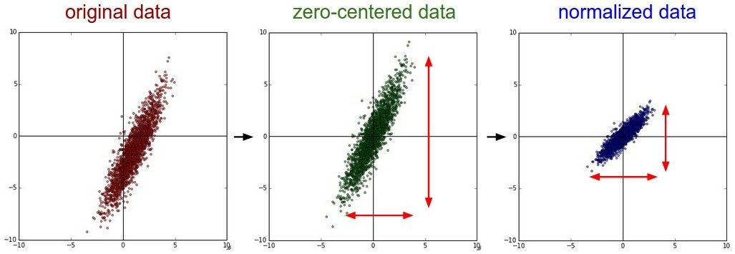
Last time: Data Preprocessing
Lecture 7 -
5
Fei-Fei Li & Justin Johnson & Serena Yeung Lecture 7 - April 24, 2018

Slide 6
Last time: Data Preprocessing
Before normalization: classification loss very sensitive to changes in weight matrix; hard to optimize
After normalization: less sensitive to small changes in weights; easier to optimize
Lecture 7 -
6
Fei-Fei Li & Justin Johnson & Serena Yeung Lecture 7 - April 24, 2018

Slide 7
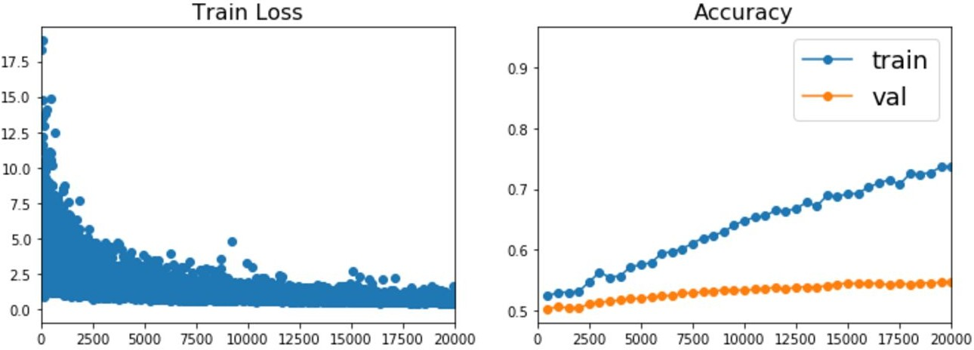
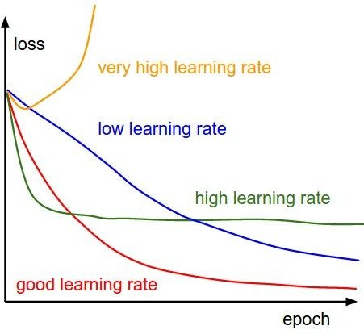
Last time: Babysitting Learning
Lecture 7 -
7
Fei-Fei Li & Justin Johnson & Serena Yeung Lecture 7 - April 24, 2018

Slide 8
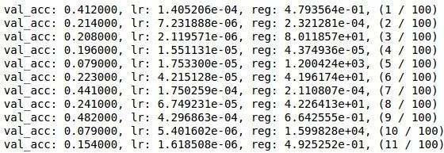
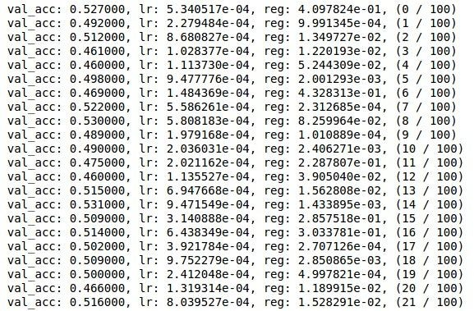
Last time: Hyperparameter Search
Coarse to fine search
Grid Layout Random Layout
Unimportant Parameter
Unimportant Parameter
Important Parameter
Important Parameter
Lecture 7 -
8
Fei-Fei Li & Justin Johnson & Serena Yeung Lecture 7 - April 24, 2018

Slide 9
Today
More normalization
Fancier optimization
Regularization
Transfer Learning
Fei-Fei Li & Justin Johnson & Serena Yeung Lecture 7 - April 24, 2018

Slide 10
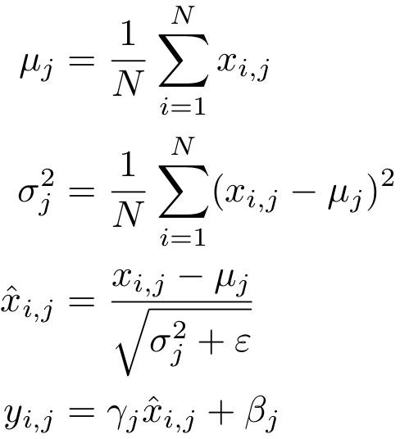
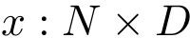
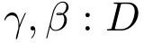
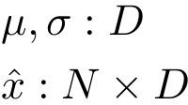
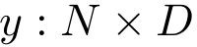
Last time: Batch Normalization
Input:
Learnable params:
Intermediates:
Output:
Fei-Fei Li & Justin Johnson & Serena Yeung Lecture 7 - April 24, 2018

Slide 11
Last time: Batch Normalization
Estimate mean and variance from minibatch; Can’t do this at test-time
Input:
Learnable params:
Intermediates:
Output:
Fei-Fei Li & Justin Johnson & Serena Yeung Lecture 7 - April 24, 2018

Slide 12
Batch Normalization: Test Time
Input:
(Running) average of values seen during training
Learnable params:
(Running) average of values seen during training
Intermediates:
Output:
Fei-Fei Li & Justin Johnson & Serena Yeung Lecture 7 - April 24, 2018

Slide 13
Batch Normalization for ConvNets
Batch Normalization for
convolutional networks
(Spatial Batchnorm, BatchNorm2D)
Batch Normalization for
fully-connected networks
x: N × D
Normalize
µ,o: 1 × D
ɣ,β: 1 × D
y = ɣ(x-µ)/o+β
x: N×C×H×W
Normalize
µ,o: 1×C×1×1
ɣ,β: 1×C×1×1
y = ɣ(x-µ)/o+β
Fei-Fei Li & Justin Johnson & Serena Yeung Lecture 7 - April 24, 2018

Slide 14
Layer Normalization
Layer Normalization for fully-connected networks
Same behavior at train and test! Can be used in recurrent networks
Batch Normalization for fully-connected networks
x: | N | × | D |  | x: N | × | D
Normalize µ,o: | 1 | × | D |  | Normalize µ,o: N | × | 1
ɣ,β: | 1 | × | D |  | ɣ,β: 1 | × | D
y = ɣ(x-µ)/o+β
Ba, Kiros, and Hinton, “Layer Normalization”, arXiv 2016
y = ɣ(x-µ)/o+β
Fei-Fei Li & Justin Johnson & Serena Yeung Lecture 7 - April 24, 2018

Slide 15
Instance Normalization
Batch Normalization for convolutional networks
Instance Normalization for convolutional networks Same behavior at train / test!
x: N×C×H×W
Normalize
µ,o: 1×C×1×1
x: N×C×H×W
Normalize
µ,o: N×C×1×1
ɣ,β: 1×C×1×1
ɣ,β: 1×C×1×1
y = ɣ(x-µ)/o+β y = ɣ(x-µ)/o+β
Ulyanov et al, Improved Texture Networks: Maximizing Quality and Diversity in Feed-forward Stylization and Texture Synthesis, CVPR 2017
Fei-Fei Li & Justin Johnson & Serena Yeung Lecture 7 - April 24, 2018

Slide 16
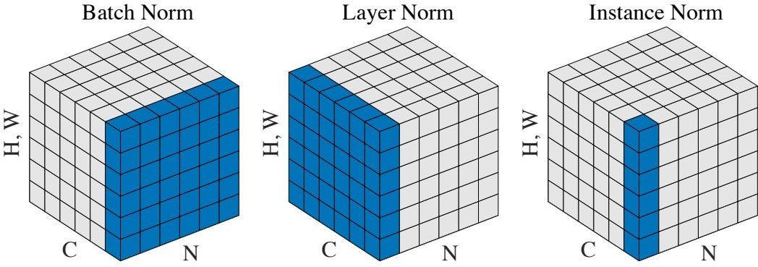
Comparison of Normalization Layers
Wu and He, “Group Normalization”, arXiv 2018
Fei-Fei Li & Justin Johnson & Serena Yeung Lecture 7 - April 24, 2018

Slide 17
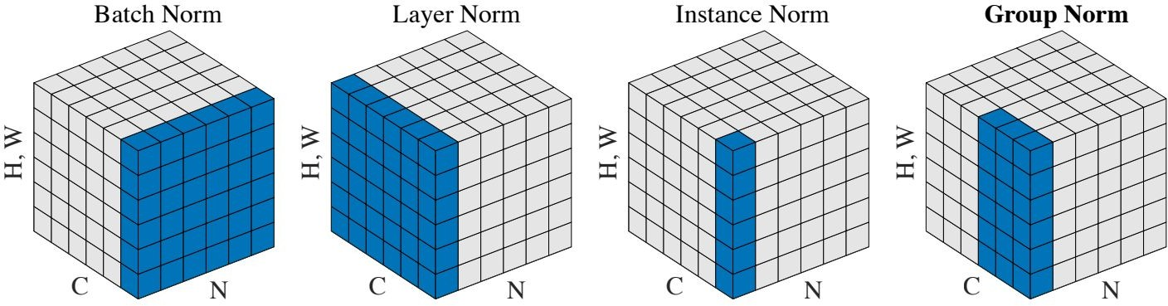
Group Normalization
Wu and He, “Group Normalization”, arXiv 2018 (Appeared 3/22/2018)
Fei-Fei Li & Justin Johnson & Serena Yeung Lecture 7 - April 24, 2018

Slide 18
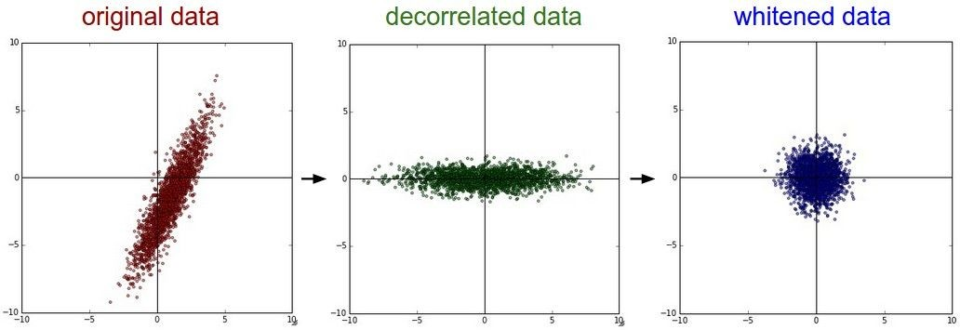
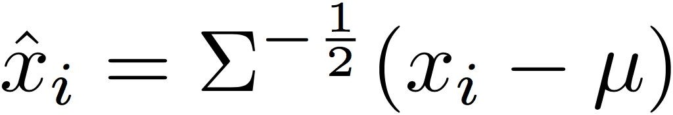
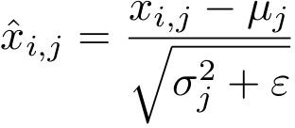
Decorrelated Batch Normalization
Batch Normalization Decorrelated Batch Normalization
BatchNorm normalizes the data, but cannot correct for correlations among the input features
DBN whitens the data using the full covariance matrix of the minibatch; this corrects for correlations
Huang et al, “Decorrelated Batch Normalization”, arXiv 2018 (Appeared 4/23/2018)

Slide 19
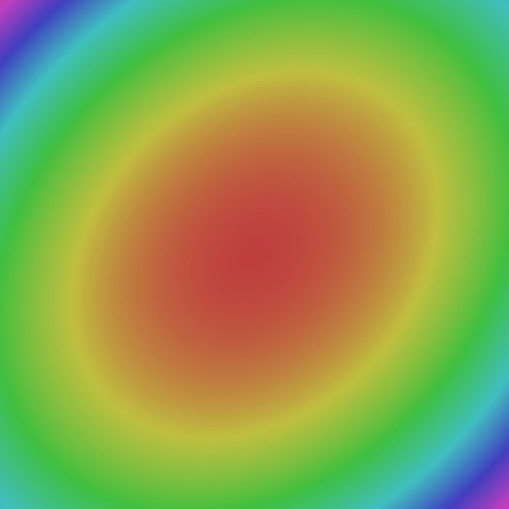
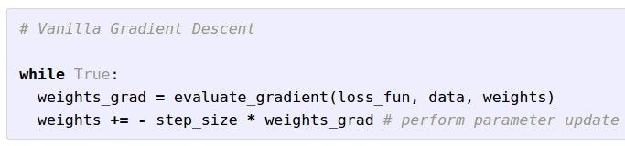

Optimization
W_2
W_1
Fei-Fei Li & Justin Johnson & Serena Yeung Lecture 7 - April 24, 2018

Slide 20
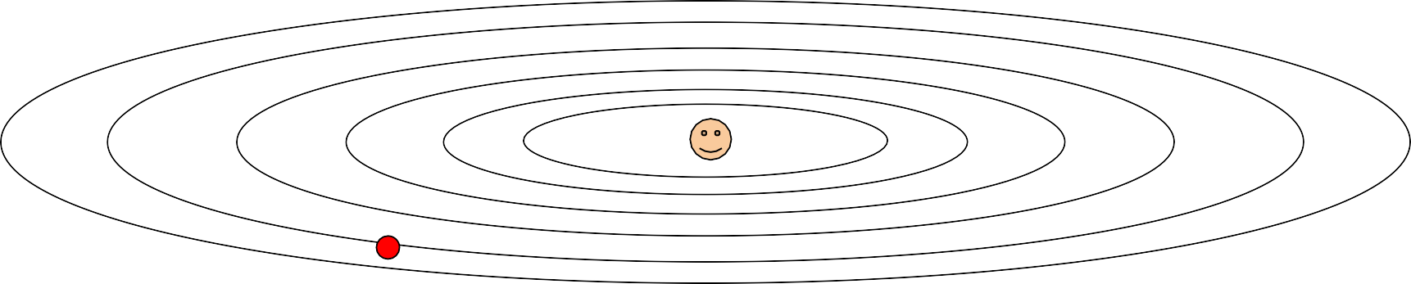
Optimization: Problems with SGD
What if loss changes quickly in one direction and slowly in another? What does gradient descent do?
Loss function has high condition number: ratio of largest to smallest
singular value of the Hessian matrix is large
Fei-Fei Li & Justin Johnson & Serena Yeung Lecture 7 - April 24, 2018

Slide 21
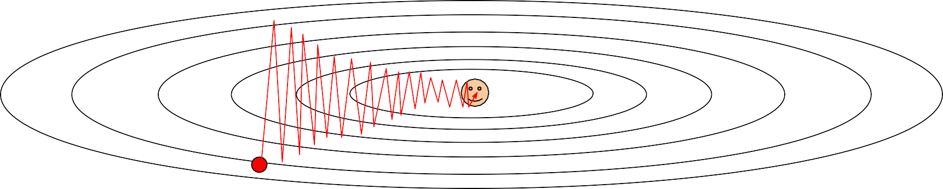
Optimization: Problems with SGD
What if loss changes quickly in one direction and slowly in another? What does gradient descent do?
Very slow progress along shallow dimension, jitter along steep direction
Loss function has high condition number: ratio of largest to smallest
singular value of the Hessian matrix is large
Fei-Fei Li & Justin Johnson & Serena Yeung Lecture 7 - April 24, 2018

Slide 22
Optimization: Problems with SGD
What if the loss function has a local minima or saddle point?
Fei-Fei Li & Justin Johnson & Serena Yeung Lecture 7 - April 24, 2018

Slide 23


Optimization: Problems with SGD
What if the loss function has a local minima or saddle point?
Zero gradient, gradient descent gets stuck
Fei-Fei Li & Justin Johnson & Serena Yeung Lecture 7 - April 24, 2018

Slide 24
Optimization: Problems with SGD
What if the loss function has a local minima or saddle point?
Saddle points much more common in high dimension
Dauphin et al, “Identifying and attacking the saddle point problem in high-dimensional non-convex optimization”, NIPS 2014
Fei-Fei Li & Justin Johnson & Serena Yeung Lecture 7 - April 24, 2018

Slide 25
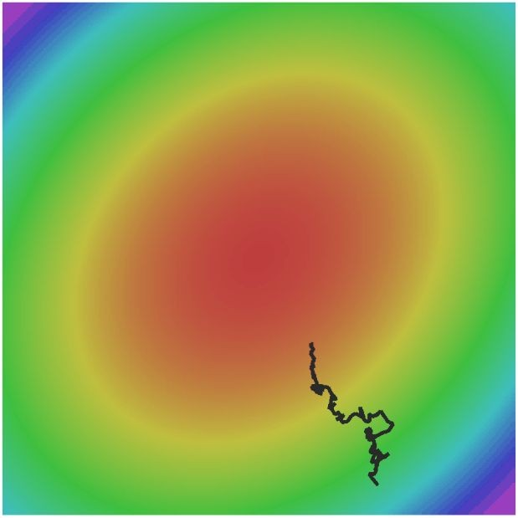
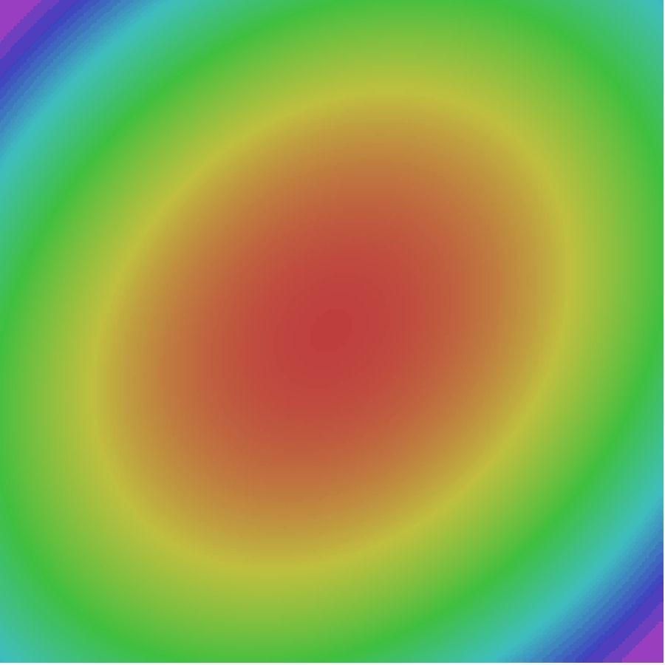
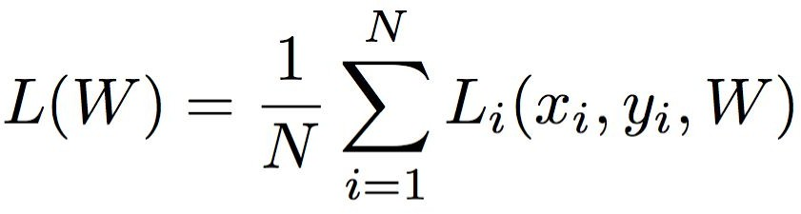
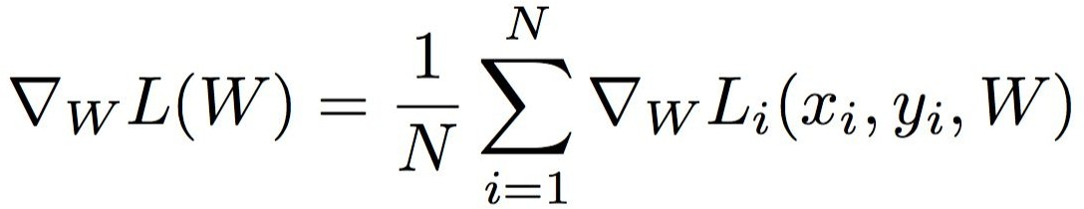
Optimization: Problems with SGD
Our gradients come from minibatches so they can be noisy!
Fei-Fei Li & Justin Johnson & Serena Yeung Lecture 7 - April 24, 2018

Slide 26
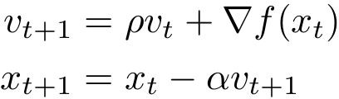
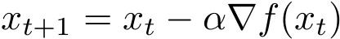
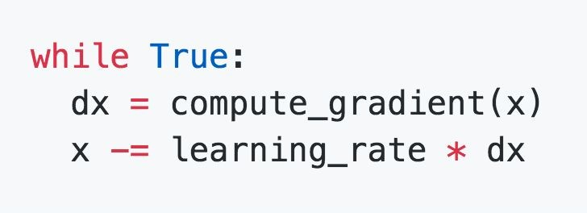
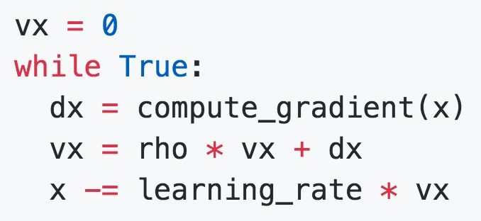
SGD + Momentum
SGD
SGD+Momentum
Build up “velocity” as a running mean of gradients
Rho gives “friction”; typically rho=0.9 or 0.99
Sutskever et al, “On the importance of initialization and momentum in deep learning”, ICML 2013
Fei-Fei Li & Justin Johnson & Serena Yeung Lecture 7 - April 24, 2018

Slide 27
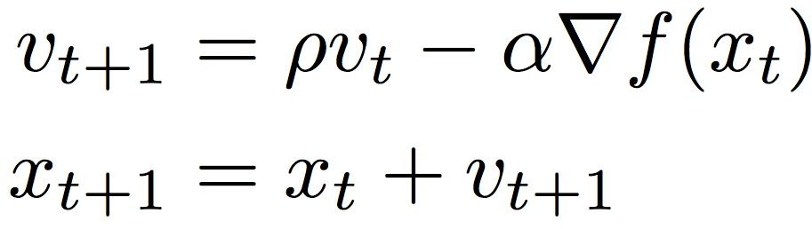
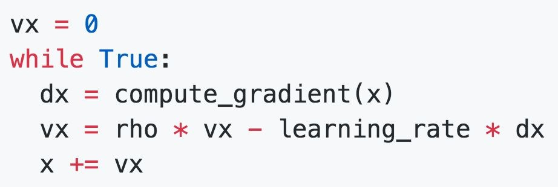
SGD + Momentum
SGD+Momentum
SGD+Momentum
You may see SGD+Momentum formulated different ways, but they are equivalent - give same sequence of x
Sutskever et al, “On the importance of initialization and momentum in deep learning”, ICML 2013
Fei-Fei Li & Justin Johnson & Serena Yeung Lecture 7 - April 24, 2018

Slide 28
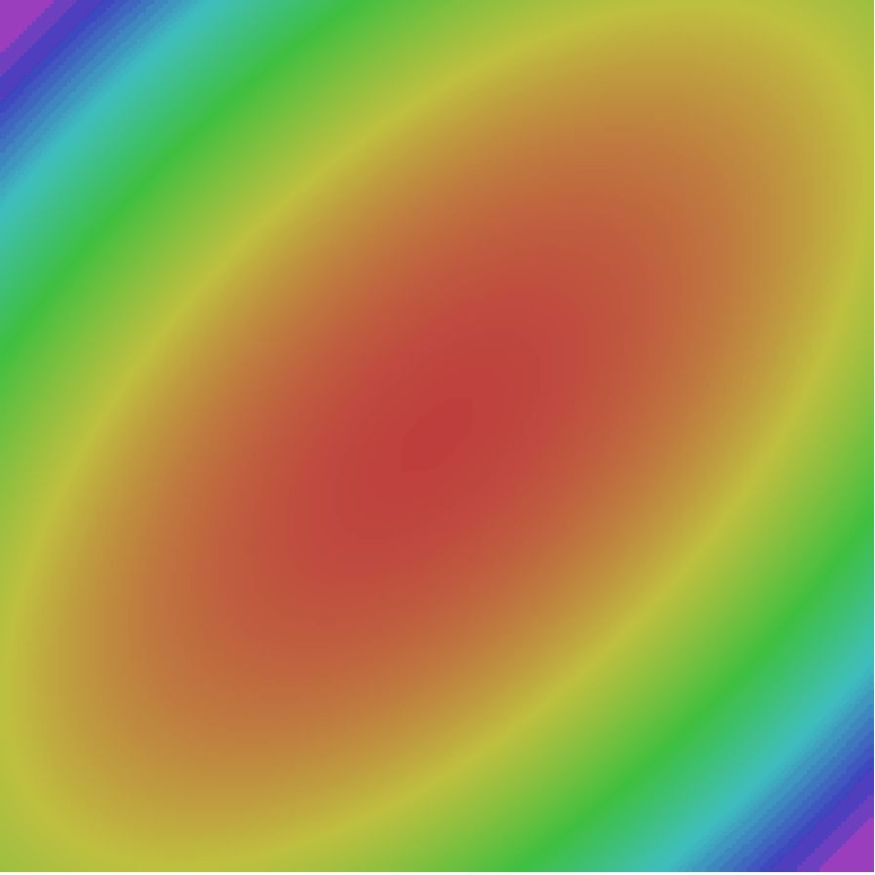
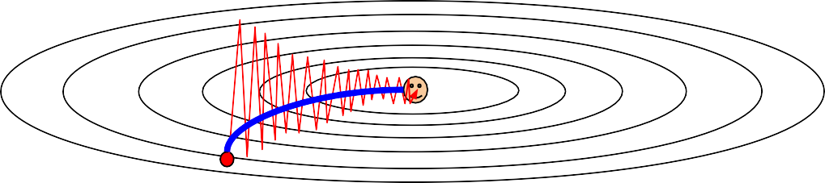
SGD + Momentum
Gradient Noise
Local Minima
Saddle points
Poor Conditioning
SGD
SGD+Momentum
Fei-Fei Li & Justin Johnson & Serena Yeung Lecture 7 - April 24, 2018

Slide 29

SGD+Momentum
Momentum update:
Velocity
actual step
Gradient
Combine gradient at current point with velocity to get step used to update weights
Nesterov, “A method of solving a convex programming problem with convergence rate O(1/k^2)”, 1983 Nesterov, “Introductory lectures on convex optimization: a basic course”, 2004
Sutskever et al, “On the importance of initialization and momentum in deep learning”, ICML 2013
Fei-Fei Li & Justin Johnson & Serena Yeung Lecture 7 - April 24, 2018

Slide 30

Nesterov Momentum
Momentum update:
Nesterov Momentum
Gradient
Velocity
Velocity
actual step
actual step
Gradient
Combine gradient at current point with velocity to get step used to update weights
Nesterov, “A method of solving a convex programming problem with convergence rate O(1/k^2)”, 1983 Nesterov, “Introductory lectures on convex optimization: a basic course”, 2004
Sutskever et al, “On the importance of initialization and momentum in deep learning”, ICML 2013
“Look ahead” to the point where updating using velocity would take us; compute gradient there and mix it with velocity to get actual update direction
Fei-Fei Li & Justin Johnson & Serena Yeung Lecture 7 - April 24, 2018

Slide 31
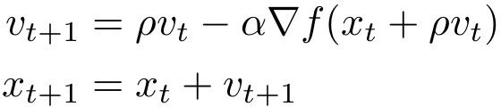
Nesterov Momentum
Gradient
Velocity
actual step
“Look ahead” to the point where updating using velocity would take us; compute gradient there and mix it with velocity to get actual update direction
Fei-Fei Li & Justin Johnson & Serena Yeung Lecture 7 - April 24, 2018

Slide 32
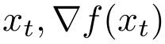
Nesterov Momentum
Annoying, usually we want update in terms of
Gradient
Velocity
actual step
“Look ahead” to the point where updating using velocity would take us; compute gradient there and mix it with velocity to get actual update direction
Fei-Fei Li & Justin Johnson & Serena Yeung Lecture 7 - April 24, 2018

Slide 33
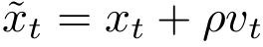
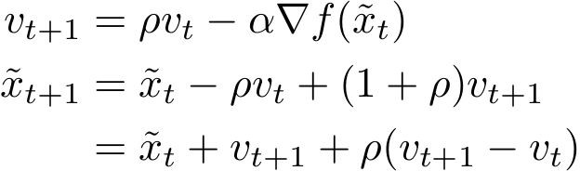
Nesterov Momentum
Annoying, usually we want update in terms of
Gradient
Velocity
Change of variables rearrange:
and
actual step
“Look ahead” to the point where updating using velocity would take us; compute gradient there and mix it with velocity to get actual update direction
Fei-Fei Li & Justin Johnson & Serena Yeung Lecture 7 - April 24, 2018

Slide 34
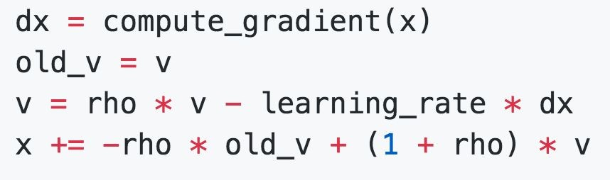
Nesterov Momentum
Annoying, usually we want update in terms of
Change of variables rearrange:
and
Fei-Fei Li & Justin Johnson & Serena Yeung Lecture 7 - April 24, 2018

Slide 35


Nesterov Momentum
SGD
SGD+Momentum Nesterov
Fei-Fei Li & Justin Johnson & Serena Yeung Lecture 7 - April 24, 2018

Slide 36

AdaGrad
Added element-wise scaling of the gradient based on the historical sum of squares in each dimension
“Per-parameter learning rates” or “adaptive learning rates”
Duchi et al, “Adaptive subgradient methods for online learning and stochastic optimization”, JMLR 2011
Fei-Fei Li & Justin Johnson & Serena Yeung Lecture 7 - April 24, 2018

Slide 37

AdaGrad
Q: What happens with AdaGrad?
Fei-Fei Li & Justin Johnson & Serena Yeung Lecture 7 - April 24, 2018

Slide 38
AdaGrad
Q: What happens with AdaGrad?
Progress along “steep” directions is damped; progress along “flat” directions is accelerated
Fei-Fei Li & Justin Johnson & Serena Yeung Lecture 7 - April 24, 2018

Slide 39
AdaGrad
Q2: What happens to the step size over long time?
Fei-Fei Li & Justin Johnson & Serena Yeung Lecture 7 - April 24, 2018

Slide 40
AdaGrad
Q2: What happens to the step size over long time?
Decays to zero
Fei-Fei Li & Justin Johnson & Serena Yeung Lecture 7 - April 24, 2018

Slide 41


RMSProp
AdaGrad
RMSProp
Tieleman and Hinton, 2012
Fei-Fei Li & Justin Johnson & Serena Yeung Lecture 7 - April 24, 2018

Slide 42

RMSProp
SGD
SGD+Momentum RMSProp
Fei-Fei Li & Justin Johnson & Serena Yeung Lecture 7 - April 24, 2018

Slide 43

Adam (almost)
Kingma and Ba, “Adam: A method for stochastic optimization”, ICLR 2015
Fei-Fei Li & Justin Johnson & Serena Yeung Lecture 7 - April 24, 2018

Slide 44
Adam (almost)
Momentum
AdaGrad / RMSProp
Sort of like RMSProp with momentum
Q: What happens at first timestep?
Kingma and Ba, “Adam: A method for stochastic optimization”, ICLR 2015
Fei-Fei Li & Justin Johnson & Serena Yeung Lecture 7 - April 24, 2018

Slide 45


Adam (full form)
Momentum
Bias correction
AdaGrad / RMSProp
Bias correction for the fact that first and second moment estimates start at zero
Kingma and Ba, “Adam: A method for stochastic optimization”, ICLR 2015
Fei-Fei Li & Justin Johnson & Serena Yeung Lecture 7 - April 24, 2018

Slide 46

Adam (full form)
Momentum
Bias correction
AdaGrad / RMSProp
Bias correction for the fact that first and second moment estimates start at zero
Adam with beta1 = 0.9,
beta2 = 0.999, and learning_rate = 1e-3 or 5e-4 is a great starting point for many models!
Kingma and Ba, “Adam: A method for stochastic optimization”, ICLR 2015
Fei-Fei Li & Justin Johnson & Serena Yeung Lecture 7 - April 24, 2018

Slide 47

Adam
SGD
SGD+Momentum RMSProp
Adam
Fei-Fei Li & Justin Johnson & Serena Yeung Lecture 7 - April 24, 2018

Slide 48
SGD, SGD+Momentum, Adagrad, RMSProp, Adam all have
learning rate as a hyperparameter.
Q: Which one of these learning rates is best to use?
Fei-Fei Li & Justin Johnson & Serena Yeung Lecture 7 - April 24, 2018

Slide 49


SGD, SGD+Momentum, Adagrad, RMSProp, Adam all have
learning rate as a hyperparameter.
=> Learning rate decay over time!
step decay:
e.g. decay learning rate by half every few epochs.
exponential decay:
1/t decay:
Fei-Fei Li & Justin Johnson & Serena Yeung Lecture 7 - April 24, 2018

Slide 50
SGD, SGD+Momentum, Adagrad, RMSProp, Adam all have
learning rate as a hyperparameter.
Loss
Learning rate decay!
Epoch
Fei-Fei Li & Justin Johnson & Serena Yeung Lecture 7 - April 24, 2018

Slide 51
SGD, SGD+Momentum, Adagrad, RMSProp, Adam all have
learning rate as a hyperparameter.
Loss
Learning rate decay!
More critical with SGD+Momentum, less common with Adam
Epoch
Fei-Fei Li & Justin Johnson & Serena Yeung Lecture 7 - April 24, 2018

Slide 52
First-Order Optimization
Loss
w1
Fei-Fei Li & Justin Johnson & Serena Yeung Lecture 7 - April 24, 2018

Slide 53

First-Order Optimization
Use gradient form linear approximation
Step to minimize the approximation
Loss
w1
Fei-Fei Li & Justin Johnson & Serena Yeung Lecture 7 - April 24, 2018

Slide 54

Second-Order Optimization
Use gradient and Hessian to form quadratic approximation
Step to the minima of the approximation
Loss
w1
Fei-Fei Li & Justin Johnson & Serena Yeung Lecture 7 - April 24, 2018

Slide 55

Second-Order Optimization
second-order Taylor expansion:
Solving for the critical point we obtain the Newton parameter update:
Q: What is nice about this update?
Fei-Fei Li & Justin Johnson & Serena Yeung Lecture 7 - April 24, 2018

Slide 56
Second-Order Optimization
second-order Taylor expansion:
Solving for the critical point we obtain the Newton parameter update:
No hyperparameters! No learning rate!
(Though you might use one in practice)
Q: What is nice about this update?
Fei-Fei Li & Justin Johnson & Serena Yeung Lecture 7 - April 24, 2018

Slide 57
Second-Order Optimization
second-order Taylor expansion:
Solving for the critical point we obtain the Newton parameter update:
Q2: Why is this bad for deep learning?
Fei-Fei Li & Justin Johnson & Serena Yeung Lecture 7 - April 24, 2018

Slide 58
Second-Order Optimization
second-order Taylor expansion:
Solving for the critical point we obtain the Newton parameter update:
Hessian has O(N^2) elements Inverting takes O(N^3)
N = (Tens or Hundreds of) Millions
Q2: Why is this bad for deep learning?
Fei-Fei Li & Justin Johnson & Serena Yeung Lecture 7 - April 24, 2018

Slide 59
Second-Order Optimization
Quasi-Newton methods (BGFS most popular):
instead of inverting the Hessian (O(n^3)), approximate inverse Hessian with rank 1 updates over time (O(n^2) each).
L-BFGS (Limited memory BFGS):
Does not form/store the full inverse Hessian.
Fei-Fei Li & Justin Johnson & Serena Yeung Lecture 7 - April 24, 2018

Slide 60
L-BFGS
- Usually works very well in full batch, deterministic mode
i.e. if you have a single, deterministic f(x) then L-BFGS will probably work very nicely
- Does not transfer very well to mini-batch setting. Gives bad results. Adapting second-order methods to large-scale, stochastic setting is an active area of research.
Le et al, “On optimization methods for deep learning, ICML 2011”
Ba et al, “Distributed second-order optimization using Kronecker-factored approximations”, ICLR 2017
Fei-Fei Li & Justin Johnson & Serena Yeung Lecture 7 - April 24, 2018

Slide 61
In practice:
Adam is a good default choice in many cases
SGD+Momentum with learning rate decay often outperforms Adam by a bit, but requires more tuning
If you can afford to do full batch updates then try out
L-BFGS (and don’t forget to disable all sources of noise)
Fei-Fei Li & Justin Johnson & Serena Yeung Lecture 7 - April 24, 2018

Slide 62
Beyond Training Error
Better optimization algorithms help reduce training loss
But we really care about error on new data - how to reduce the gap?
Fei-Fei Li & Justin Johnson & Serena Yeung Lecture 7 - April 24, 2018

Slide 63
Early Stopping
Train Val
Loss
Accuracy
Stop training here
Iteration
Iteration
Stop training the model when accuracy on the validation set decreases
Or train for a long time, but always keep track of the model snapshot that worked best on val
Fei-Fei Li & Justin Johnson & Serena Yeung Lecture 7 - April 24, 2018

Slide 64
Model Ensembles
Train multiple independent models
At test time average their results
(Take average of predicted probability distributions, then choose argmax)
Enjoy 2% extra performance
Fei-Fei Li & Justin Johnson & Serena Yeung Lecture 7 - April 24, 2018

Slide 65

Model Ensembles: Tips and Tricks
Instead of training independent models, use multiple snapshots of a single model during training!
Loshchilov and Hutter, “SGDR: Stochastic gradient descent with restarts”, arXiv 2016 Huang et al, “Snapshot ensembles: train 1, get M for free”, ICLR 2017
Figures copyright Yixuan Li and Geoff Pleiss, 2017. Reproduced with permission.
Fei-Fei Li & Justin Johnson & Serena Yeung Lecture 7 - April 24, 2018

Slide 66


Model Ensembles: Tips and Tricks
Instead of training independent models, use multiple snapshots of a single model during training!
Cyclic learning rate schedules can make this work even better!
Loshchilov and Hutter, “SGDR: Stochastic gradient descent with restarts”, arXiv 2016 Huang et al, “Snapshot ensembles: train 1, get M for free”, ICLR 2017
Figures copyright Yixuan Li and Geoff Pleiss, 2017. Reproduced with permission.
Lecture 7 - 67
Fei-Fei Li & Justin Johnson & Serena Yeung Lecture 7 - April 24, 2018

Slide 67

Model Ensembles: Tips and Tricks
Instead of using actual parameter vector, keep a moving average of the parameter vector and use that at test time (Polyak averaging)
Polyak and Juditsky, “Acceleration of stochastic approximation by averaging”, SIAM Journal on Control and Optimization, 1992.
Fei-Fei Li & Justin Johnson & Serena Yeung Lecture 7 - April 24, 2018

Slide 68
How to improve single-model performance?
Regularization
Fei-Fei Li & Justin Johnson & Serena Yeung Lecture 7 - April 24, 2018

Slide 69



Regularization: Add term to loss
In common use: L2 regularization L1 regularization
Elastic net (L1 + L2)
(Weight decay)
Fei-Fei Li & Justin Johnson & Serena Yeung Lecture 7 - April 24, 2018

Slide 70



Regularization: Dropout
In each forward pass, randomly set some neurons to zero Probability of dropping is a hyperparameter; 0.5 is common
Srivastava et al, “Dropout: A simple way to prevent neural networks from overfitting”, JMLR 2014
Fei-Fei Li & Justin Johnson & Serena Yeung Lecture 7 - April 24, 2018

Slide 71




Regularization: Dropout
Example forward pass with a
3-layer network using dropout
Fei-Fei Li & Justin Johnson & Serena Yeung Lecture 7 - April 24, 2018

Slide 72



Regularization: Dropout
How can this possibly be a good idea?
Forces the network to have a redundant representation; Prevents co-adaptation of features
has an ear
has a tail is furry has claws
mischievous X
look
X
X
cat score
Fei-Fei Li & Justin Johnson & Serena Yeung Lecture 7 - April 24, 2018

Slide 73
Regularization: Dropout
How can this possibly be a good idea?
Another interpretation:
Dropout is training a large ensemble of models (that share parameters).
Each binary mask is one model
An FC layer with 4096 units has 2⁴⁰⁹⁶ ~ 10¹²³³ possible masks!
Only ~ 10⁸² atoms in the universe...
Fei-Fei Li & Justin Johnson & Serena Yeung Lecture 7 - April 24, 2018

Slide 74


Dropout: Test time
Output (label)
Input (image)
Dropout makes our output random!
Random mask
Want to “average out” the randomness at test-time
But this integral seems hard …
Fei-Fei Li & Justin Johnson & Serena Yeung Lecture 7 - April 24, 2018

Slide 75


Dropout: Test time
Want to approximate the integral
Consider a single neuron.
a
w₁
w₂
x
y
Fei-Fei Li & Justin Johnson & Serena Yeung Lecture 7 - April 24, 2018

Slide 76

Dropout: Test time
Want to approximate the integral
Consider a single neuron.
a
At test time we have:
w₁
w₂
x
y
Fei-Fei Li & Justin Johnson & Serena Yeung Lecture 7 - April 24, 2018

Slide 77


Dropout: Test time
Want to approximate the integral
Consider a single neuron.
a
At test time we have: During training we have:
w₁
w₂
x
y
Fei-Fei Li & Justin Johnson & Serena Yeung Lecture 7 - April 24, 2018

Slide 78
Dropout: Test time
Want to approximate the integral
Consider a single neuron.
a
At test time we have: During training we have:
w₁
w₂
x
y
At test time, multiply
by dropout probability
Fei-Fei Li & Justin Johnson & Serena Yeung Lecture 7 - April 24, 2018

Slide 79

Dropout: Test time
At test time all neurons are active always
=> We must scale the activations so that for each neuron: output at test time = expected output at training time
Fei-Fei Li & Justin Johnson & Serena Yeung Lecture 7 - April 24, 2018

Slide 80

Dropout Summary
drop in forward pass
scale at test time
Fei-Fei Li & Justin Johnson & Serena Yeung Lecture 7 - April 24, 2018

Slide 81

More common: “Inverted dropout”
test time is unchanged!
Fei-Fei Li & Justin Johnson & Serena Yeung Lecture 7 - April 24, 2018

Slide 82

Regularization: A common pattern
Training: Add some kind of randomness
Testing: Average out randomness (sometimes approximate)
Fei-Fei Li & Justin Johnson & Serena Yeung Lecture 7 - April 24, 2018

Slide 83
Regularization: A common pattern
Training: Add some kind of randomness
Example: Batch Normalization
Training: Normalize using stats from random minibatches
Testing: Use fixed stats to normalize
Testing: Average out randomness (sometimes approximate)
Fei-Fei Li & Justin Johnson & Serena Yeung Lecture 7 - April 24, 2018

Slide 84

Regularization: Data Augmentation
“cat”
Load image and label
Compute loss
CNN
This image by Nikita is licensed under CC-BY 2.0
Fei-Fei Li & Justin Johnson & Serena Yeung Lecture 7 - April 24, 2018

Slide 85

Regularization: Data Augmentation
“cat”
Load image and label
Compute loss
CNN
Transform image
Fei-Fei Li & Justin Johnson & Serena Yeung Lecture 7 - April 24, 2018

Slide 86

Data Augmentation
Horizontal Flips
Fei-Fei Li & Justin Johnson & Serena Yeung Lecture 7 - April 24, 2018

Slide 87
Data Augmentation
Random crops and scales
Training: sample random crops / scales
ResNet:
Pick random L in range [256, 480]
Resize training image, short side = L
Sample random 224 x 224 patch
Fei-Fei Li & Justin Johnson & Serena Yeung Lecture 7 - April 24, 2018

Slide 88
Data Augmentation
Random crops and scales
Training: sample random crops / scales
ResNet:
Pick random L in range [256, 480]
Resize training image, short side = L
Sample random 224 x 224 patch
Testing: average a fixed set of crops
ResNet:
1. Resize image at 5 scales: {224, 256, 384, 480, 640}
2. For each size, use 10 224 x 224 crops: 4 corners + center, + flips
Fei-Fei Li & Justin Johnson & Serena Yeung Lecture 7 - April 24, 2018

Slide 89

Data Augmentation
Color Jitter
Simple: Randomize contrast and brightness
Fei-Fei Li & Justin Johnson & Serena Yeung Lecture 7 - April 24, 2018

Slide 90
Data Augmentation
Color Jitter
Simple: Randomize contrast and brightness
More Complex:
Apply PCA to all [R, G, B] pixels in training set
Sample a “color offset” along principal component directions
Add offset to all pixels of a training image
(As seen in [Krizhevsky et al. 2012], ResNet, etc)
Fei-Fei Li & Justin Johnson & Serena Yeung Lecture 7 - April 24, 2018

Slide 91
Data Augmentation
Get creative for your problem!
Random mix/combinations of :
translation
rotation
stretching
shearing,
lens distortions, … (go crazy)
Fei-Fei Li & Justin Johnson & Serena Yeung Lecture 7 - April 24, 2018

Slide 92
Regularization: A common pattern
Training: Add random noise
Testing: Marginalize over the noise
Examples: Dropout
Batch Normalization Data Augmentation
Fei-Fei Li & Justin Johnson & Serena Yeung Lecture 7 - April 24, 2018

Slide 93
Regularization: A common pattern
Training: Add random noise
Testing: Marginalize over the noise
Examples: Dropout
Batch Normalization Data Augmentation DropConnect
Wan et al, “Regularization of Neural Networks using DropConnect”, ICML 2013
Fei-Fei Li & Justin Johnson & Serena Yeung Lecture 7 - April 24, 2018

Slide 94

Regularization: A common pattern
Training: Add random noise
Testing: Marginalize over the noise
Examples: Dropout
Batch Normalization Data Augmentation DropConnect Fractional Max Pooling
Graham, “Fractional Max Pooling”, arXiv 2014
Lecture 7 - 95
Fei-Fei Li & Justin Johnson & Serena Yeung Lecture 7 - April 24, 2018

Slide 95
Regularization: A common pattern
Training: Add random noise
Testing: Marginalize over the noise
Examples: Dropout
Batch Normalization Data Augmentation DropConnect Fractional Max Pooling Stochastic Depth
Huang et al, “Deep Networks with Stochastic Depth”, ECCV 2016
Fei-Fei Li & Justin Johnson & Serena Yeung Lecture 7 - April 24, 2018

Slide 96
Transfer Learning
“You need a lot of a data if you want to train/use CNNs”
Fei-Fei Li & Justin Johnson & Serena Yeung Lecture 7 - April 24, 2018

Slide 97
Transfer Learning
“You need a lot of a data if you want to train/use CNNs”
BUSTED
Fei-Fei Li & Justin Johnson & Serena Yeung Lecture 7 - April 24, 2018

Slide 98
Transfer Learning with CNNs
Donahue et al, “DeCAF: A Deep Convolutional Activation Feature for Generic Visual Recognition”, ICML 2014 Razavian et al, “CNN Features Off-the-Shelf: An Astounding Baseline for Recognition”, CVPR Workshops 2014
1. Train on Imagenet
FC-1000
FC-4096
FC-4096
MaxPool
Conv-512
Conv-512
MaxPool
Conv-512
Conv-512
MaxPool
Conv-256
Conv-256
MaxPool
Conv-128
Conv-128
MaxPool
Conv-64
Conv-64
Image
Fei-Fei Li & Justin Johnson & Serena Yeung Lecture 7 - April 24, 2018

Slide 99

Transfer Learning with CNNs
Donahue et al, “DeCAF: A Deep Convolutional Activation Feature for Generic Visual Recognition”, ICML 2014 Razavian et al, “CNN Features Off-the-Shelf: An Astounding Baseline for Recognition”, CVPR Workshops 2014
1. Train on Imagenet
2. Small Dataset (C classes)
FC-1000
FC-4096
FC-4096
 | FC-C
 | FC-4096
 | FC-4096
Reinitialize this and train
MaxPool
Conv-512
Conv-512
MaxPool
Conv-512
Conv-512
MaxPool
Conv-512
Conv-512
MaxPool
Conv-512
Conv-512
MaxPool
Conv-256
Conv-256
MaxPool
Conv-256
Conv-256
Freeze these
MaxPool
Conv-128
Conv-128
MaxPool
Conv-128
Conv-128
MaxPool
Conv-64
Conv-64
MaxPool
Conv-64
Conv-64
Image
Image
Lecture 7 - ¹⁰
Fei-Fei Li & Justin Johnson & Serena Yeung Lecture 7 - April 24, 2018
0

Slide 100
Transfer Learning with CNNs
Donahue et al, “DeCAF: A Deep Convolutional Activation Feature for Generic Visual Recognition”, ICML 2014 Razavian et al, “CNN Features Off-the-Shelf: An Astounding Baseline for Recognition”, CVPR Workshops 2014
3. Bigger dataset
1. Train on Imagenet
2. Small Dataset (C classes)
FC-1000
FC-4096
FC-4096
 | FC-C
 | FC-4096
 | FC-4096
FC-C
FC-4096
FC-4096
Reinitialize this and train
Train these
MaxPool
Conv-512
Conv-512
MaxPool
Conv-512
Conv-512
MaxPool
Conv-512
With bigger dataset, train more layers
Conv-512
MaxPool
Conv-512
Conv-512
MaxPool
Conv-512
Conv-512
MaxPool
Conv-512
Conv-512
MaxPool
Conv-256
Conv-256
MaxPool
Conv-256
Conv-256
Freeze these
MaxPool
Conv-256
Conv-256
Freeze these
Lower learning rate when finetuning; 1/10 of original LR is good starting point
MaxPool
Conv-128
Conv-128
MaxPool
Conv-128
Conv-128
MaxPool
Conv-128
Conv-128
MaxPool
Conv-64
Conv-64
MaxPool
Conv-64
Conv-64
MaxPool
Conv-64
Conv-64
Image
Image
Image
Lecture 7 - ¹⁰
Fei-Fei Li & Justin Johnson & Serena Yeung Lecture 7 - April 24, 2018
1

Slide 101
 | very similar dataset | very different dataset
very little data | ? | ?
quite a lot of data | ? | ?
FC-1000
FC-4096
FC-4096
MaxPool
Conv-512
Conv-512
MaxPool
Conv-512
Conv-512
More specific
More generic
MaxPool
Conv-256
Conv-256
MaxPool
Conv-128
Conv-128
MaxPool
Conv-64
Conv-64
Image
Lecture 7 - ¹⁰
Fei-Fei Li & Justin Johnson & Serena Yeung Lecture 7 - April 24, 2018
2

Slide 102
 | very similar dataset | very different dataset
very little data | Use Linear Classifier on top layer | ?
quite a lot of data | Finetune a few layers | ?
FC-1000
FC-4096
FC-4096
MaxPool
Conv-512
Conv-512
MaxPool
Conv-512
Conv-512
More specific
More generic
MaxPool
Conv-256
Conv-256
MaxPool
Conv-128
Conv-128
MaxPool
Conv-64
Conv-64
Image
Lecture 7 - ¹⁰
Fei-Fei Li & Justin Johnson & Serena Yeung Lecture 7 - April 24, 2018
3

Slide 103
 | very similar dataset | very different dataset
very little data | Use Linear Classifier on top layer | You’re in trouble… Try linear classifier from different stages
quite a lot of data | Finetune a few layers | Finetune a larger number of layers
FC-1000
FC-4096
FC-4096
MaxPool
Conv-512
Conv-512
MaxPool
Conv-512
Conv-512
More specific
More generic
MaxPool
Conv-256
Conv-256
MaxPool
Conv-128
Conv-128
MaxPool
Conv-64
Conv-64
Image
Lecture 7 - ¹⁰
Fei-Fei Li & Justin Johnson & Serena Yeung Lecture 7 - April 24, 2018
4

Slide 104


Transfer learning with CNNs is pervasive…
(it’s the norm, not an exception)
Object Detection
(Fast R-CNN)
Image Captioning: CNN + RNN
Karpathy and Fei-Fei, “Deep Visual-Semantic Alignments for Generating Image Descriptions”, CVPR 2015
Figure copyright IEEE, 2015. Reproduced for educational purposes.
Girshick, “Fast R-CNN”, ICCV 2015
Figure copyright Ross Girshick, 2015. Reproduced with permission.
Lecture 7 - ¹⁰
Fei-Fei Li & Justin Johnson & Serena Yeung Lecture 7 - April 24, 2018
5

Slide 105
Transfer learning with CNNs is pervasive…
(it’s the norm, not an exception)
Object Detection
CNN pretrained on ImageNet
(Fast R-CNN)
Image Captioning: CNN + RNN
Karpathy and Fei-Fei, “Deep Visual-Semantic Alignments for Generating Image Descriptions”, CVPR 2015
Figure copyright IEEE, 2015. Reproduced for educational purposes.
Girshick, “Fast R-CNN”, ICCV 2015
Figure copyright Ross Girshick, 2015. Reproduced with permission.
Lecture 7 - ¹⁰
Fei-Fei Li & Justin Johnson & Serena Yeung Lecture 7 - April 24, 2018
6

Slide 106
Transfer learning with CNNs is pervasive…
(it’s the norm, not an exception)
Object Detection
CNN pretrained on ImageNet
(Fast R-CNN)
Image Captioning: CNN + RNN
Word vectors pretrained
with word2vec
Karpathy and Fei-Fei, “Deep Visual-Semantic Alignments for Generating Image Descriptions”, CVPR 2015
Figure copyright IEEE, 2015. Reproduced for educational purposes.
Girshick, “Fast R-CNN”, ICCV 2015
Figure copyright Ross Girshick, 2015. Reproduced with permission.
Lecture 7 - ¹⁰
Fei-Fei Li & Justin Johnson & Serena Yeung Lecture 7 - April 24, 2018
7

Slide 107
Takeaway for your projects and beyond:
Have some dataset of interest but it has < ~1M images?
Find a very large dataset that has similar data, train a big ConvNet there
Transfer learn to your dataset
Deep learning frameworks provide a “Model Zoo” of pretrained models so you don’t need to train your own
Caffe: https://github.com/BVLC/caffe/wiki/Model-Zoo TensorFlow: https://github.com/tensorflow/models PyTorch: https://github.com/pytorch/vision
Lecture 7 - ¹⁰
Fei-Fei Li & Justin Johnson & Serena Yeung Lecture 7 - April 24, 2018
8

Slide 108
Summary
Lots of Batch Normalization variants
Optimization
Momentum, RMSProp, Adam, etc
Regularization
Dropout, etc
Transfer learning
Use this for your projects!
Lecture 7 - ¹⁰
Fei-Fei Li & Justin Johnson & Serena Yeung Lecture 7 - April 24, 2018
9

Slide 109
Next time: Deep Learning Software!
Lecture 7 - ¹¹
Fei-Fei Li & Justin Johnson & Serena Yeung Lecture 7 - April 24, 2018
0

